Slide 1
Time Management

Slide 2
Project Vision and Background
The idea of this project is to allow users to manage the tasks that they need to complete and assign them to days that they can do them. This will allow users to manage their time efficiently so that they complete all they need to in the time that they have.
People have been using calendars for years to manage when certain tasks need to be done, and a digital calendar will allow users to manage their time from any device anywhere. This will allow users to be organised and get tasks completed before the deadline.
Consideration must be taken regarding the accessibility of this project when the interface is designed. If the site is not accessible then the target audience is limited, and would go against the UK Equality Act of 2010. The Equality Act states that reasonable steps must be taken to make a website more inclusive.

Slide 3
Sprints
Sprint 1
Create introduction for documentation
Create product vision
Research background
Create wireframes
Sprint 2
Create UML diagrams
Program the template for the application:
Nav bar
Calendar
Log in page
Register page

Slide 4
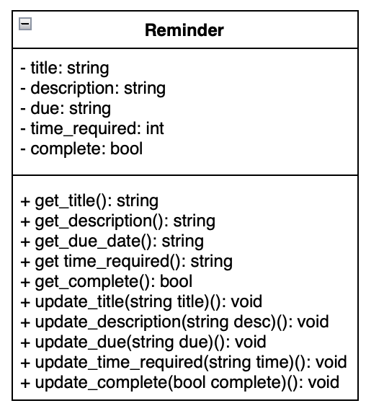
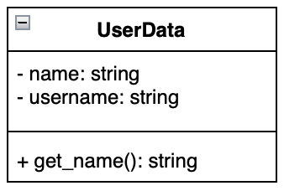
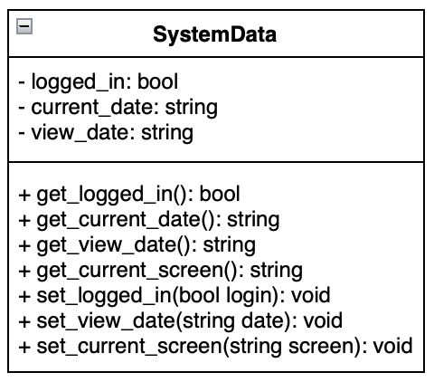
UML Models

Slide 5
Challenges
Getting the calendar to scroll back and forward to other weeks

